Slide 1




SPAM AND HAM DETECTION
Under the guidance of:
Dr. Chethan H K,
Professor,
Dept. of Computer Science & Engineering,
Maharaja Institute of Technology Thandavapura

Slide 2


OUR TEAM
Pavan M V
Gagana H P
4MN21CS033
4MN21CS017

Slide 3

CONTENT
01
Introduction to Problem Stetement
02
Objective
03
Existing System Drawbacks
04
Proposed System Advantages
05
Application of Proposed system
06
Literature Survey
07
Requirement Specification
08
09
10
Design
Implementation
Snapshots

Slide 4



INTRODUCTION
An SMS spam message is an unwanted or unsolicited text message which is sent to the user's mobile phone with various content types, such as advertisements, awards, free services and promotions.
This project aims to develop a Machine learning model to detect spam messages SMS text data .It utilizes natural language processing techinques and a supervised learning algorithm to classify SMS messages as either Spam or Ham.
The main goal of spammers is to steal critical user information such as username, password, and credit card details.

Slide 5





OBJECTIVES
SPAM
HAM
The primary objective of a spam message detection system is to accurately identify and filter out unsolicited and potentially harmful spam messages
The primary objective of a ham message detection system is to ensure that legitimate, useful, and relevant messages (ham) are accurately identified and delivered to users without being mistakenly classified as spam.

Slide 6


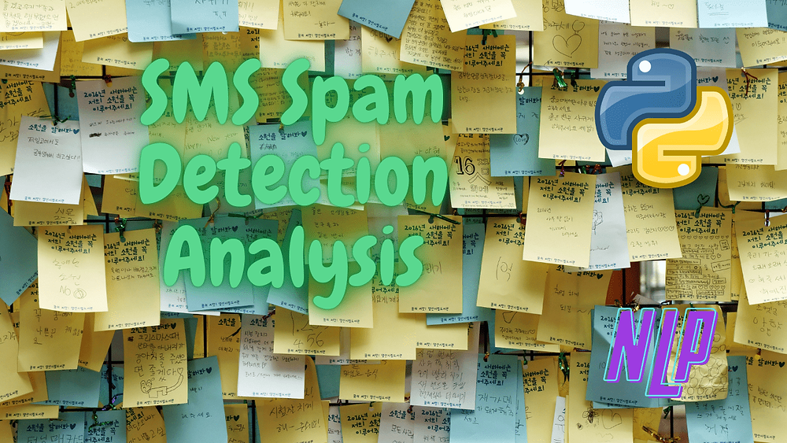
EXISTING SYSTEM
Mission
Spam and ham detection refers to the process of identifying and filtering out unwanted or irrelevant emails (spam) from those that are legitimate and useful (ham).
Various methods and systems have been developed to achieve this, combining Rule-Based Systems, statistical and machine learning approaches.
Vision
Traditional Methods: Modern Methods:
Rule-based System Machine Learning
Statistical Filtering
Eg: Blacklists and Whitelists Eg: Naive Bayes , Decision tree

Slide 7
PROPOSED SYSTEM
Data Collection and Preprocessing
Feature Extraction
Model Training

Slide 8



APPLICATION
Email Services
Social Media Platforms
Messaging Applications
Telecomunication
CUSTOMERS

Slide 9

LITERATURE SURVEY
S.Sheikhi (2021)
The spam has become a big internet issues.The statistics showed spam accounted for 55% of all messeges.SMS provides the perfect ways to send the unwanted advertisement or junk news group posting at no cost for the sender.
Suman Kumar Das (2021)
SMS is one of the most effective form of communication.It is based on cellular communication system just the cell phone needs to be the network coverage area in order to send or receive the message.

Slide 10


01
02
03
04
B Uday Reddy
(2022)
P Gopala Krishna
(2023)
Vaman Ashqisced
(2023)
Mandar Shivajihanchate
(2023)
The spam has become a big internet issues. In 2017 the statistics showed spam accounted for 55% of all messages.
.
A smishing Detector was proposed in the recognize message with a lower bogus positive rate than the present status of the craftsmanship model.
It first separate the texture feature from the attribute feature of the image part of the email then classifies both sets of feature using SVM method.
The scope of this research includes a through literature on SMS classification and AI technologies in order to identify the most appropriate methods and techinques for building the classification model.

Slide 11


SYSTEM REQUIREMENTS SPECIFICATIONS
HARDWARE REQUIREMENTS
SOFTWARE REQUIREMENTS
RAM: 4GB
Processor : Processor: A modern processor (e.g., Intel Core i5 or equivalent).
OS: Windows 10 or later.
Language used:
IDE: Python.
Google Colabratery
libraries imported
Numpy
Pandas
Streamlit

Slide 12
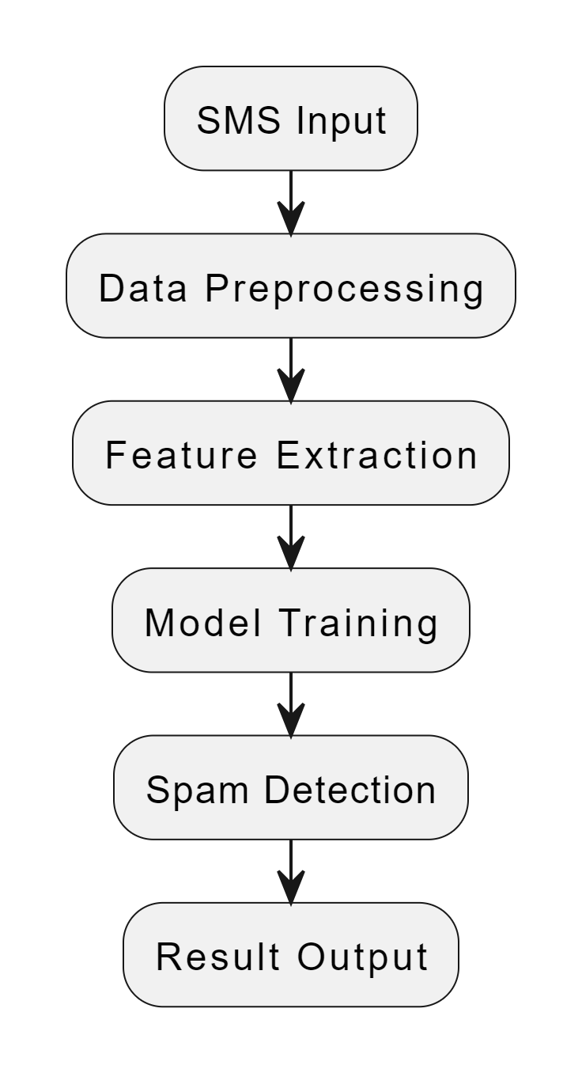
DESIGN
Fig : Data flow Diagram

Slide 13
Data Collection
Data Cleaning
Generating Testing and training data
Generating word cloud vector
Predictions based on SMS input
Fig : Work flow Diagram

Slide 14
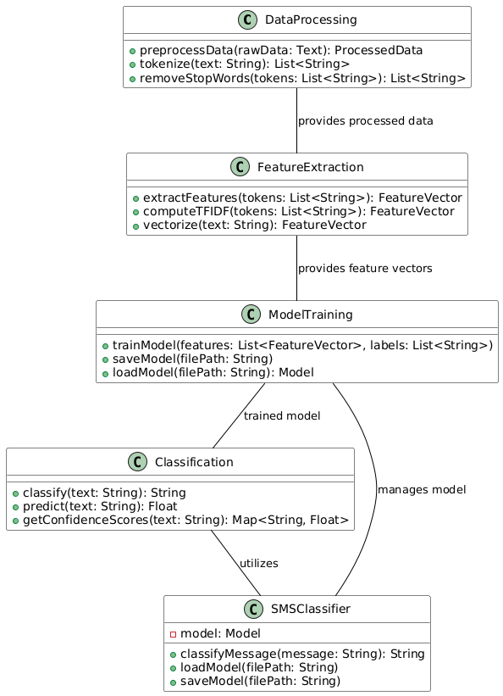
CLASS DIAGRAM

Slide 15
IMPLEMENTATION
KNN Method: It is important to examine a database in which the data points have been divided into a large number of distinct categories in order to anticipate the categorization of a new sample points.
Naïve Bayes algorithm: It assumes that the features (SMS message) are independent of each other given the class label. Despite this strong independence assumption, Naive Bayes often performs for text classification tasks.

Slide 16
STEPS:
Collect the datasets.
We will clean the dataset by removing unwanted columns and renaming the necessary ones.
Pre-processing of text data.
Extract features using the TF-IDF Vectorizer.
Split the data into training and testing sets.
Train the model using Naive Bayes.
Evaluating the model .
Deploying the model.

Slide 17
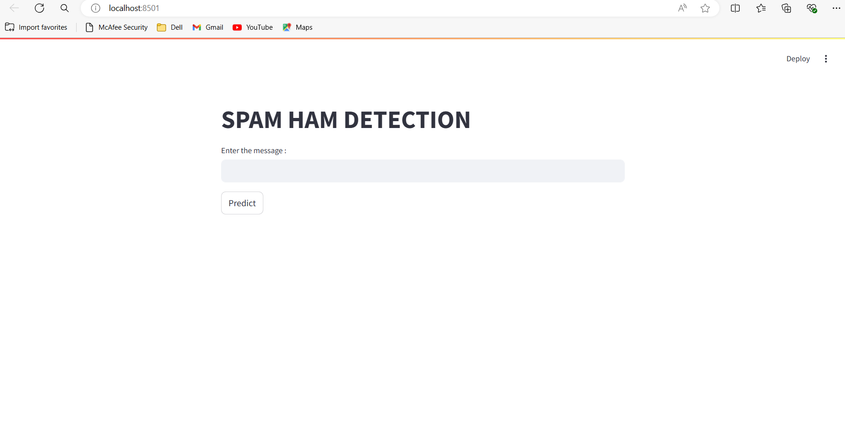
Snapshots

Slide 18
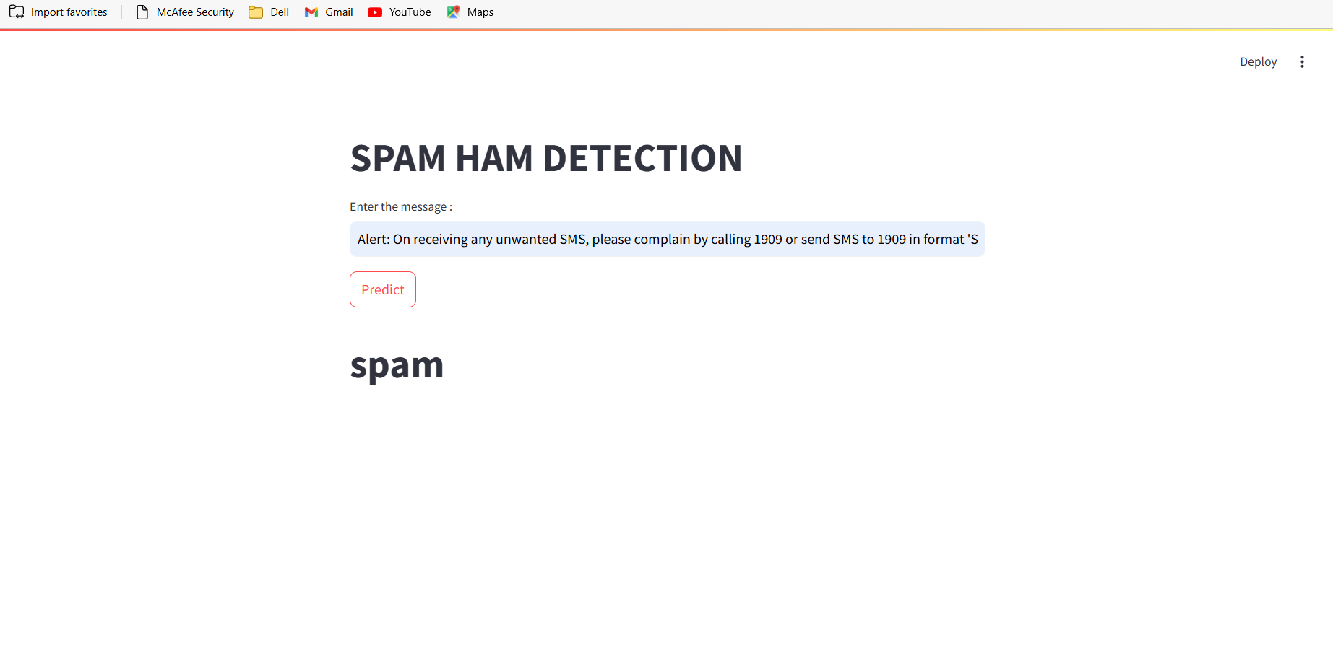

Slide 19
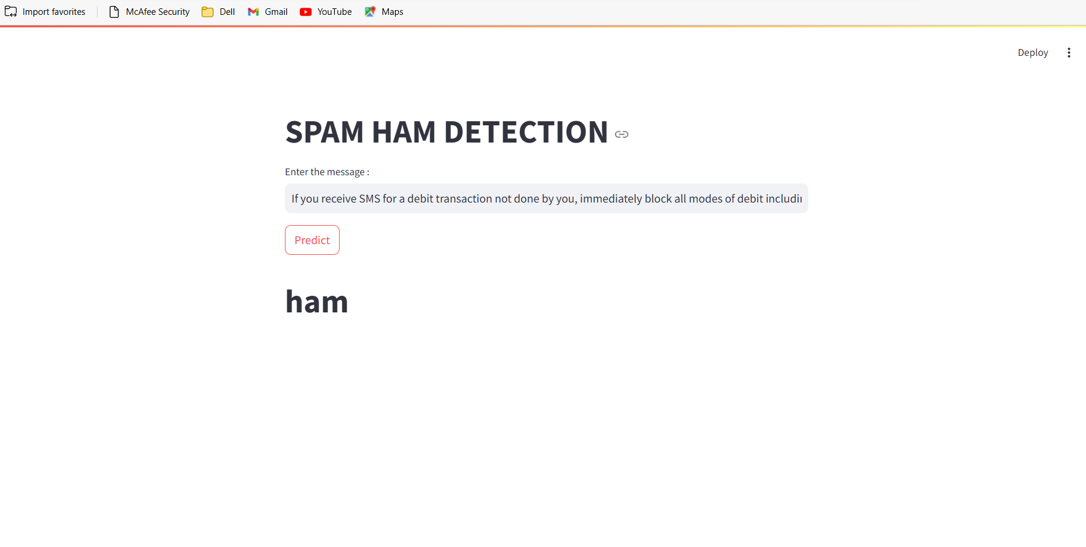

Slide 20
Any Queries ?

Slide 21


Thank You Listeners!

